Slide 1
Understanding individual Behavior
Chapter
14
© 2007 Prentice Hall, Inc.
All rights reserved.

Slide 2
L E A R N I N G O U T L I N E
Follow this Learning Outline as you read and study this chapter.
Why Look at Individual Behavior?
  Explain why the concept of an organization as an iceberg is important to understanding organizational behavior.
  Describe the focus and the goals of organizational behavior.
  Define the six important employee behaviors that managers want to explain, predict, and influence.
Attitudes
  Describe the three components of an attitude.
  Discuss three job-related attitudes.
  Describe the impact job satisfaction has on employee behavior.
© 2007 Prentice Hall, Inc. All rights reserved.
14–<number>

Slide 3
L E A R N I N G O U T L I N E (cont’d)
Follow this Learning Outline as you read and study this chapter.
Attitudes (cont’d)
  Explain how individuals reconcile inconsistencies between attitudes and behavior.
Personality
  Contrast the MBTI and the big-five model of personality.
  Describe the five personality traits that have proved to be most powerful in explaining individual behavior in organizations.
  Explain how emotions and emotional intelligence impact behavior.
© 2007 Prentice Hall, Inc. All rights reserved.
14–<number>

Slide 4
L E A R N I N G O U T L I N E (cont’d)
Follow this Learning Outline as you read and study this chapter.
Perception
  Explain how an understanding of perception can help managers.
  Describe the key elements of attribution theory.
  Discuss how the fundamental attribution error and self-serving bias can distort attributions.
  Name three shortcuts used in judging others.
Learning
  Explain how operant conditioning helps managers understand, predict, and influence behavior.
  Describe the implications of social learning theory for managing people at work.
© 2007 Prentice Hall, Inc. All rights reserved.
14–<number>

Slide 5
L E A R N I N G O U T L I N E (cont’d)
Follow this Learning Outline as you read and study this chapter.
Learning (cont’d)
  Discuss how managers can shape behavior.
Contemporary OB Issues
  Describe the challenges managers face in managing Gen Y workers.
  Explain what managers can do to deal with workplace misbehavior.
© 2007 Prentice Hall, Inc. All rights reserved.
14–<number>

Slide 6

Self-Awareness: You Need to
Know Yourself Before You Can
Know Others
To grow and succeed, we need to also understand our strengths and weaknesses
Knowing yourself helps you:
Improve where needed
Understand how others see you
Make better choices in life and work
© 2007 Prentice Hall, Inc. All rights reserved.
1–<number>

Slide 7
🔑 5 Key Parts of Your Personality
1. Introversion vs. Extraversion
Introverts: Like quiet, deep thinking, and working alone.
Extraverts: Like being around people, action, and variety.
2. Thinking vs. Feeling
Thinkers: Make decisions with logic and facts.
Feelers: Make decisions based on emotions and values.
3. Internal vs. External Control
Internal control: You believe you shape your own future.
External control: You think outside forces (luck, fate) control your life.
4. Organized vs. Disorganized
Organized: Reliable, responsible, meet deadlines.
Disorganized: Easily distracted, often late or unprepared.
5. Open to Change vs. Comfortable with the Familiar
Open to change: Curious, creative, like new things.
Comfortable with the familiar: Like routine and dislike change.
🧠 Important: There’s no “right” or “wrong” personality. Each style has good and bad sides. What matters is knowing who you are and where you fit best.
© 2007 Prentice Hall, Inc. All rights reserved.
1–<number>

Slide 8
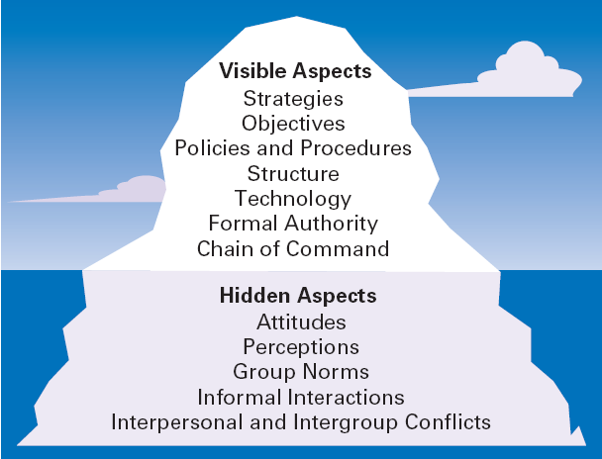
Exhibit 14.1 The Organization as an Iceberg
© 2007 Prentice Hall, Inc. All rights reserved.
14–<number>

Slide 9
💡 Example: Market Basket Protest
More than 25,000 employees at Market Basket, a family-owned supermarket in New England, protested for two months after their CEO, Arthur T. Demoulas, was fired because of a fight with his cousin, Arthur S. Demoulas.
Arthur T. was a well-liked leader. He:
Paid employees more than average
Promoted from within the company
Clearly communicated with his workers
Because of this, employees were very loyal to him.
When he was fired:
Workers protested
Customers and suppliers joined the boycott
The company lost around $70 million each day
Eventually, the pressure forced the company to bring Arthur T. back as CEO.
Arthur S. learned the hard way how powerful the hidden behaviors and emotions in a company can be — even if everything looks fine on the surface.
© 2007 Prentice Hall, Inc. All rights reserved.
1–<number>

Slide 10
Why Look at Individual Behavior?
Behavior:
“The actions of people”
Organizational Behavior (OB)
“The study of the actions of people at work”
Focus of Organizational Behavior
  Individual behavior
    Attitudes, personality, perception, learning, and motivation
  Group behavior
    Norms, roles, team building, leadership, and conflict
Goals of Organizational Behavior
  To explain, predict and influence behavior.
© 2007 Prentice Hall, Inc. All rights reserved.
14–<number>

Slide 11
Goals of Organizational Behavior
OB helps managers understand people at work. It has three main goals:
Explain behavior – Why do employees act a certain way?
Predict behavior – How will employees react to a decision or change?
Influence behavior – How can we guide employees to act in positive ways?
© 2007 Prentice Hall, Inc. All rights reserved.
1–<number>

Slide 12
What employee behaviors are managers most concerned about?
There are six important employee behaviors that OB focuses on:
© 2007 Prentice Hall, Inc. All rights reserved.
1–<number>

Slide 13

Important Employee Behaviors
Employee Productivity
  A performance measure of both efficiency and effectiveness
Absenteeism
  Failure to show up for work
Turnover
  The voluntary and involuntary
  permanent withdrawal from
  an organization
© 2007 Prentice Hall, Inc. All rights reserved.
14–<number>

Slide 14
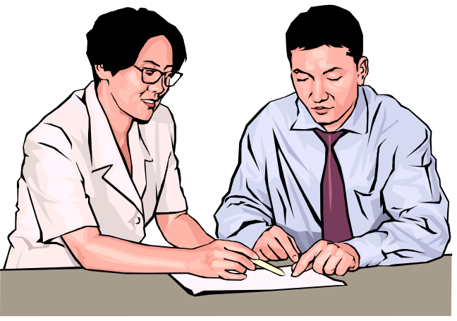
Important Employee Behaviors (cont’d)
Organizational Citizenship Behavior (OCB)
  Discretionary behavior that is not a part of an employee’s formal job requirements, but which promotes the effective functioning of the organization.
  Examples: Helping teammates, volunteering, staying positive, and avoiding conflict.
  Companies with good OCB often perform better.
  But too much of it can cause stress or burnout.
Job Satisfaction
  The individual’s general attitude
  toward his or her job
© 2007 Prentice Hall, Inc. All rights reserved.
14–<number>

Slide 15
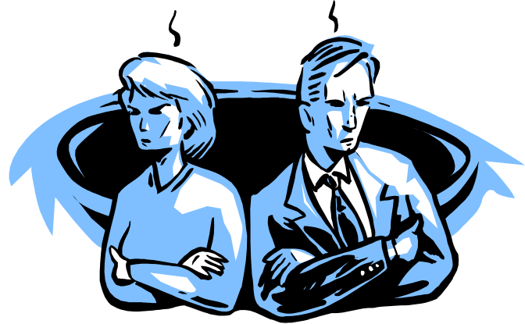
Important Employee Behaviors (cont’d)
Workplace Misbehavior
  Any intentional employee behavior that has negative consequences for the organization or individuals within the organization.
  Types of Misbehavior
    Deviance
    Aggression
    Breaking rules
    Violence
    These behaviors can damage the workplace and hurt other employees.
© 2007 Prentice Hall, Inc. All rights reserved.
14–<number>

Slide 16
Psychological Factors Affecting Employee Behavior
Employee Productivity
Absenteeism
Turnover
Organizational Citizenship
Job Satisfaction
Workplace Misbehavior
Attitudes
Personality
Perception
Learning
© 2007 Prentice Hall, Inc. All rights reserved.
14–<number>

Slide 17
Psychological Factors
Attitudes
  Evaluative statements—either favorable or unfavorable—concerning objects, people, or events.
When a person says, “I like my job,” he or she is expressing an attitude about work.
An attitude is made up of three components
Components Of An Attitude
  Cognitive component: the beliefs, opinions, knowledge, or information held by a person( for instance, the belief that “discrimination is wrong”)
  Affective component: the emotional or feeling part of an attitude. “I feel upset and angry when I see someone being treated unfairly.”
  Behavioral component: the intention to behave in a certain way.” I might choose to avoid Pat because of my feelings about him.”
© 2007 Prentice Hall, Inc. All rights reserved.
14–<number>

Slide 18
Psychological Factors (cont’d)
Job Satisfaction
  Job satisfaction is affected by level of income earned and by the type of job a worker does.
Job Satisfaction and Productivity
  For individuals, productivity appears to lead to job satisfaction.
  For organizations, those with more satisfied employees are more effective than those with less satisfied employees.
© 2007 Prentice Hall, Inc. All rights reserved.
14–<number>

Slide 19
Psychological Factors (cont’d)
Job Satisfaction and Absenteeism
  Satisfied employees tend to have lower levels of absenteeism.
Job Satisfaction and Turnover
  Satisfied employees have lower levels of turnover; dissatisfied employees have higher levels of turnover.
  Turnover is affected by the level of employee performance.
    The preferential treatment afforded superior employees makes satisfaction less important in predicting their turnover decisions.
© 2007 Prentice Hall, Inc. All rights reserved.
14–<number>

Slide 20
🔑 Job Satisfaction & Retaining Top Performers
Top performers are less likely to quit, even if job satisfaction is low.
📈 Companies try hard to keep them with:
Pay raises
Praise
Promotions
✅ How Managers Can Boost Job Satisfaction
🎯 Identify incentives employees truly value.
💡 Example:
Darius Fisher, President of Status Labs
Rewards for meeting sales goals include:
  🎟️ Festival passes
  ⌚ Apple Watches
  🧼 Home cleaning services
💰 While these seem expensive, they are cheaper than losing and replacing employees.
© 2007 Prentice Hall, Inc. All rights reserved.
1–<number>

Slide 21
Psychological Factors (cont’d)
Job Satisfaction and Customer Satisfaction
  The level of job satisfaction for frontline employees is related to increased customer satisfaction and loyalty.
  Interaction with dissatisfied customers can increase an employee’s job dissatisfaction.
  Actions to increase job satisfaction for customer service workers:
    Hire upbeat and friendly employees.
    Reward superior customer service.
    Provide a positive work climate.
    Use attitude surveys to track employee satisfaction.
© 2007 Prentice Hall, Inc. All rights reserved.
14–<number>

Slide 22
Psychological Factors (cont’d)
Job Satisfaction and Workplace Misbehavior
  Dissatisfied employees will respond somehow
  Not easy to predict exactly how they’ll respond
© 2007 Prentice Hall, Inc. All rights reserved.
14–<number>

Slide 23
Psychological Factors (cont’d)
Job Involvement
  The degree to which an employee identifies with his or her job, actively participates in it, and considers his or her performance to be important to his or her self-worth.
  Job involvement means how much a person cares about their job, and how much they see it as a part of who they are.
    High levels of commitment are related to fewer absences and lower resignation rates.
  ✅ Example:
  Rita is a nurse who truly loves helping people. She:
  Stays late if a patient needs extra care
  Feels proud when she does her job well
  Thinks her work is a big part of who she is
  👉 Rita has high job involvement.
© 2007 Prentice Hall, Inc. All rights reserved.
14–<number>

Slide 24
Psychological Factors (cont’d)
Organizational Commitment
  Is the degree to which an employee identifies with a particular organization and its goals and wishes to maintain membership in the organization.
  Organizational commitment means how much an employee connects with the company, supports its goals, and wants to stay with the company.
  Leads to lower levels of both absenteeism and turnover.
  Could be becoming an outmoded measure as the number of workers who change employers increases.
© 2007 Prentice Hall, Inc. All rights reserved.
14–<number>

Slide 25
Organizational Commitment
✅ Example:
John works at a tech company. He believes:
The company cares about him
His work is appreciated
He agrees with the company’s goals
👉 Even if his current project isn’t perfect, he wants to stay with the company.
That’s organizational commitment.
© 2007 Prentice Hall, Inc. All rights reserved.
1–<number>

Slide 26
Psychological Factors (cont’d)
Perceived Organizational Support
  Is the general belief of employees that their organization values their contribution and cares about their well-being.
  Represents the commitment of the organization to the employee.
  Providing high levels of support increases job satisfaction and lower turnover.
© 2007 Prentice Hall, Inc. All rights reserved.
14–<number>

Slide 27
Attitudes and Consistency
People like to be consistent — they want their thoughts, beliefs, and actions to match. When something doesn’t match (called inconsistency), it can make them feel uncomfortable or confused. To fix that feeling, they often change their attitude, change their behavior, or make excuses to explain the difference.
People seek consistency in two ways:
  Consistency among their attitudes.
  Consistency between their attitudes and behaviors.
If an inconsistency arises, individuals:
  Alter their attitudes
  Alter their behavior
  Develop a rationalization for the inconsistency
© 2007 Prentice Hall, Inc. All rights reserved.
1–<number>

Slide 28
Attitudes and Consistency
🧍 Example : The campus recruiter
Recruiter works for a company (Enterprise Rent-a-Car) and travels to colleges to tell students it’s a great place to work. But privately, he thinks the company is actually not great due poor working conditions and few opportunities for promotion.
This mismatch between what he says and what he believes creates discomfort. To deal with it, he might:
Change his belief: Start to believe the company is good, because he keeps saying it is.
Change his behavior: Stop talking positively about the company, or even start criticizing it.
Rationalize: Say to himself, “My job is just to promote the good parts — no company is perfect.”
© 2007 Prentice Hall, Inc. All rights reserved.
14–<number>

Slide 29
Cognitive Dissonance Theory
  Any incompatibility or inconsistency between attitudes or between behavior and attitudes.
    Any form of inconsistency is uncomfortable and individuals will try to reduce the dissonance.
    Dissonance = conflict, tension, or inconsistency between ideas, beliefs, or actions.
  Cognitive dissonance is the mental discomfort we feel when we hold two conflicting beliefs, values, or behaviors.
  Example: If someone believes smoking is bad but continues to smoke, they experience dissonance between their belief and behavior. They may try to reduce it by changing their behavior (quitting) or justifying it (“It helps me relax”).
© 2007 Prentice Hall, Inc. All rights reserved.
14–<number>

Slide 30
Factors influencing the intensity of dissonance
    1.The importance of the factors creating the dissonance.
    The more important the belief or issue, the stronger the discomfort.
    Example: Dissonance about health (important) feels stronger than dissonance about choosing a brand (less important).
    2. The degree to which an individual believes that the factors causing the dissonance are controllable. If Ravi feels he can quit smoking but doesn’t, dissonance increases.
    If he feels addicted and unable to quit, dissonance is reduced.
© 2007 Prentice Hall, Inc. All rights reserved.
14–<number>

Slide 31
Factors influencing the intensity of dissonance cont.…..
3. Rewards available to compensate for the dissonance.
Large rewards or external justifications can reduce dissonance.
Example: If Ravi smokes because his job involves tobacco testing and he’s paid well, the reward may compensate for the dissonance.
© 2007 Prentice Hall, Inc. All rights reserved.
1–<number>

Slide 32
Attitude Surveys
Attitude Surveys
  A instrument/document that presents employees with a set of statements or questions eliciting how they feel about their jobs, work groups, supervisors, or their organization.
  Provide management with feedback on employee perceptions of the organization and their jobs.
© 2007 Prentice Hall, Inc. All rights reserved.
14–<number>

Slide 33
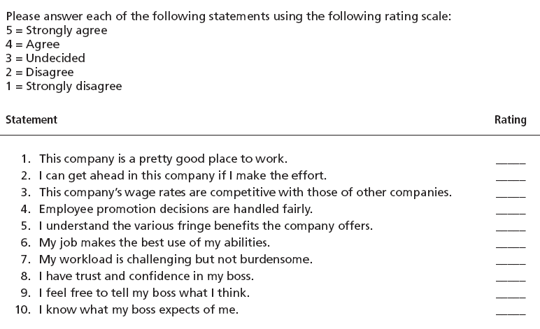
Exhibit 14.2 Sample Attitude Survey
© 2007 Prentice Hall, Inc. All rights reserved.
14–<number>
Source: Based on T. Lammers, “The Essential Employee Survey,” Inc., December 1992, pp. 159–161.

Slide 34
The Importance of Attitudes
Implication for Managers
  Managers should be interested in their employees’ attitudes because they influence behavior.
    Satisfied and committed employees
    for instance:Lower rates of turnover and absenteeism especially among their more productive employees
    Managers should do things that generate the positive attitudes that reduce absenteeism and turnover.
© 2007 Prentice Hall, Inc. All rights reserved.
14–<number>

Slide 35
The Importance of Attitudes
Implication for Managers
  Attitudes influence behaviors of employees:
  Managers should focus on helping employees become more productive to increase job satisfaction. managers should focus on those factors that have been shown to be conducive to high levels of employee job satisfaction:
  making work challenging and
  interesting, providing equitable rewards,
  creating supportive working conditions, and
  encouraging supportive colleagues.
© 2007 Prentice Hall, Inc. All rights reserved.
14–<number>

Slide 36
The Importance of Attitudes
Implication for Managers
  Managers should also survey (useful pieces of information an organization) employees about their attitudes
  Employees will try to reduce dissonance: when employees must do something that conflicts with their values or attitudes, Managers should help reduce this dissonance.
  Example: An employee believes in quality but is asked to speed up production, reducing quality standards. This creates dissonance the employee feels uneasy doing something they disagree with.
© 2007 Prentice Hall, Inc. All rights reserved.
14–<number>

Slide 37
The Importance of Attitudes
  Managers identify the external sources of dissonance forces such as competitors, customers, or other factors
© 2007 Prentice Hall, Inc. All rights reserved.
1–<number>

Slide 38

Personality
Personality
  The unique combination of psychological characteristics (measurable traits) that affect how a person reacts and interacts with others.
  terms such as quiet, passive, loud, aggressive, ambitious, extraverted, loyal, tense, or sociable,
© 2007 Prentice Hall, Inc. All rights reserved.
14–<number>

Slide 39
Classifying Personality Traits
Myers Briggs Type Indicator (MBTI®)
  A general personality assessment tool that measures the personality of an individual using four categories:
    Social interaction: Extrovert or Introvert (E or I)
    Preference for gathering data: Sensing or Intuitive (S or N)
    Preference for decision making: Feeling or Thinking (F or T)
    Style of decision making: Perceptive or Judgmental (P or J)
  The MBTI helps classify people into 16 personality types based on how they interact with others (E–I), gather information (S–N), make decisions (T–F), and deal with the external world (J–P).
  It’s useful for understanding differences at work — not for judging who is “better,” but for helping managers build balanced and effective teams.
© 2007 Prentice Hall, Inc. All rights reserved.
14–<number>

Slide 40
The Four MBTI Dimensions
1. Extraversion (E) vs. Introversion (I)
Extraverts (E): Outgoing, talkative, sociable, energized by people and action.
→ Prefer team projects, meetings, and dynamic workplaces.
Introverts (I): Quiet, reflective, prefer solitary or small-group settings.
→ Prefer independent work and calm, structured environments.
Example:
An extraverted salesperson loves attending client meetings and networking events.
An introverted researcher enjoys focusing on data analysis in a quiet lab.
© 2007 Prentice Hall, Inc. All rights reserved.
1–<number>

Slide 41
The Four MBTI Dimensions cont…..
2. Sensing (S) vs. Intuition (N)
Sensing (S): Practical, detail-oriented, prefer facts and routines.
→ Good at step-by-step tasks and following established procedures.
Intuition (N): Imaginative, big-picture thinkers, prefer innovation and ideas.
→ Good at strategy, innovation, and solving new problems.
Example:
A sensing engineer prefers working with detailed blueprints and proven designs.
An intuitive designer loves brainstorming new product ideas without strict rules.
© 2007 Prentice Hall, Inc. All rights reserved.
1–<number>

Slide 42
The Four MBTI Dimensions cont.…..
3.Thinking (T) vs. Feeling (F)
Thinking (T): Logical, analytical, value fairness and objectivity.
→ Make decisions based on facts, not emotions.
Feeling (F): Empathetic, value harmony and relationships.
→ Make decisions based on personal values and people’s feelings.
Example:
A thinking manager decides promotions based purely on performance data.
A feeling manager considers both performance and how the decision affects morale.
© 2007 Prentice Hall, Inc. All rights reserved.
1–<number>

Slide 43
The Four MBTI Dimensions cont.…..
4. Judging (J) vs. Perceiving (P)
Judging (J): Organized, structured, like planning and closure.
→ Prefer fixed schedules and clear deadlines.
Perceiving (P): Flexible, spontaneous, like keeping options open.
→ Prefer adaptable environments with freedom and exploration.
Example:
A judging project manager makes detailed timelines and sticks to them.
A perceiving artist likes to explore ideas freely and adapt as inspiration comes.
© 2007 Prentice Hall, Inc. All rights reserved.
1–<number>

Slide 44
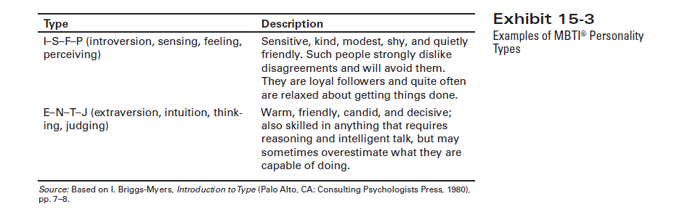
Exhibit 14.3 Examples of MBTI® Types
© 2007 Prentice Hall, Inc. All rights reserved.
14–<number>
Source: Based on I. Briggs-Myers, Introduction to Type (Palo Alto, CA: Consulting Psychologists Press, 1980), pp. 7–8.

Slide 45
The Big-Five Model:
Personality trait model that includes
Extraversion
  Sociable, talkative, and assertive, comfortable in relationship with others
Agreeableness
  Good-natured, cooperative, and trusting
Conscientiousness
The degree to which someone is reliable, responsible, dependable, persistent, and achievement oriented
Emotional Stability
  The degree to which someone is calm, enthusiastic, and secure (positive) or tense, nervous, depressed, and insecure (negative).
Openness to Experience
  Imaginative, artistically
  sensitive, and intellectual
© 2007 Prentice Hall, Inc. All rights reserved.
14–<number>

Slide 46
Relationship between traits and job performance
Five categories of occupations: professionals (such as engineers, architects, and attorneys),police, managers, salespeople, and semiskilled and skilled employees
Conscientiousness predicted job performance for all five occupational groups
Extraversion predicted performance in managerial and sales positions—occupations in which high social interaction is necessary.
Openness to relates to how well people learn during training.
Emotional security wasn’t positively related to job performance in any of the occupations.
Employees who score higher in conscientiousness develop higher levels of job knowledge, probably because highly conscientious people learn more. know more, and perform better at work.
© 2007 Prentice Hall, Inc. All rights reserved.
1–<number>

Slide 47
Other Personality Insights
Locus of Control
  “A personality attribute that measures the degree to which people believe they control their own fate”
  Others believing that what happens to them in their lives is due to luck or chance.
Internal locus: persons who believe that they control their own destiny.
External locus: persons who believe that what happens to them is due to luck or chance (the uncontrollable effects of outside forces) .
© 2007 Prentice Hall, Inc. All rights reserved.
14–<number>

Slide 48
Other Personality Insights
Employees can have two ways of thinking about control — external or internal.
Externals believe that what happens to them is mostly due to luck, other people, or outside forces.
They are usually less satisfied and less involved in their jobs.
If they get a bad performance review, they might say, “My boss is unfair” or “My coworkers made me look bad.”
Internals believe that their own actions determine what happens.
They take responsibility for their results.
If they get a bad review, they might say, “I need to work harder or improve my skills.”
So, internals feel more in control and are often happier and more motivated at work.
© 2007 Prentice Hall, Inc. All rights reserved.
14–<number>

Slide 49
Other Personality Insights
Machiavellianism (Mach)
  The degree to which an individual is pragmatic, maintains emotional distance, and seeks to gain and manipulate power—ends can justify means.
  Machiavellianism (Mach) means being practical, emotionally detached, and focused on achieving goals, even if it means using manipulation.
  A person high in Machiavellianism believes that “the end justifies the means.”
  High-Mach people make good employees depends on the job: High productive in jobs bargaining skills or substantial rewards for excelling (such as a salesperson working on commission), like sales or purchasing
© 2007 Prentice Hall, Inc. All rights reserved.
1–<number>

Slide 50
Other Personality Insights (cont’d)
Self-Esteem (SE)
  “The degree to which people like or dislike themselves”
  For example, self-esteem is directly related to expectations for success.
  High SEs
    Believe in themselves and expect success.
    Take more risks and use unconventional approaches.
    Are more satisfied with their jobs than Low SEs.
  Low SEs :means a person doesn’t feel very confident about themselves
    They are easily influenced by others — they care a lot about what people think.
    They depend on others’ approval to feel good about themselves.
© 2007 Prentice Hall, Inc. All rights reserved.
14–<number>

Slide 51
Other Personality Insights (cont’d)
Self-Monitoring
  An individual’s ability to adjust his or her behavior to external, situational factors.
  High self-monitors:
    Are sensitive to external cues and behave differently in different situations.
    Can present contradictory public persona and private selves—impression management.
  Low self-monitors
    Do not adjust their behavior to the situation.
    Are behaviorally consistent in public and private.
© 2007 Prentice Hall, Inc. All rights reserved.
14–<number>

Slide 52
Risk-Taking
  The propensity (or willingness) to take risks.
    High risk-takers take less time and require less information than low risk-takers when making a decision.
    For instance, in one study where managers worked on simulated exercises that required them to make hiring decisions, high risk-taking managers took less time to make decisions and used less information in making their choices than low risk-taking managers, the decision accuracy was the same for the two groups.
    Organizational effectiveness (how well a company performs) is best when a manager’s willingness to take risks matches the needs of their job.
    Example: A manager in innovation or product development needs to take more risks to try new ideas. A manager in accounting or safety compliance should take fewer risks because mistakes can be costly.
© 2007 Prentice Hall, Inc. All rights reserved.
14–<number>

Slide 53


Emotions
Emotions
  Intense feelings (reactions) that are directed at specific objects (someone or something)
  Universal emotions:
    Anger
    Fear
    Sadness
    Happiness
    Disgust
    Surprise
© 2007 Prentice Hall, Inc. All rights reserved.
14–<number>

Slide 54
Emotional Intelligence
Emotional Intelligence (EI)
  Emotional Intelligence (EI) is a set of skills that help a person handle challenges, pressure, and relationships successfully.
  Dimensions of EI:
    Self-awareness: The ability to be aware of what you’re feeling.
    Self-management: managing emotions and reactions
    Self-motivation: Keeping yourself going even when things get hard.
    Empathy: sensing how others are feeling
    Social skills: handling the emotions of others
    Example: Resolving a conflict between coworkers calmly
© 2007 Prentice Hall, Inc. All rights reserved.
14–<number>

Slide 55
Implications for Managers
Employee selection
Helps in understanding employee behavior(s)
By understanding others’ behavior(s), can work better with them
© 2007 Prentice Hall, Inc. All rights reserved.
14–<number>

Slide 56
Understanding Personality Differences
Personality-Job Fit Theory (Holland)
  An employee’s job satisfaction and likelihood of turnover depends on the compatibility of the employee’s personality and occupation.
  Holland’s theory proposes that satisfaction is highest and turnover lowest when personality and occupation are compatible
  Key points of the theory:
    There are differences in personalities.
    There are different types of jobs.
    people in job environments compatible with their personality types should be more satisfied and less likely to resign voluntarily than people in incongruent jobs.
© 2007 Prentice Hall, Inc. All rights reserved.
14–<number>

Slide 57
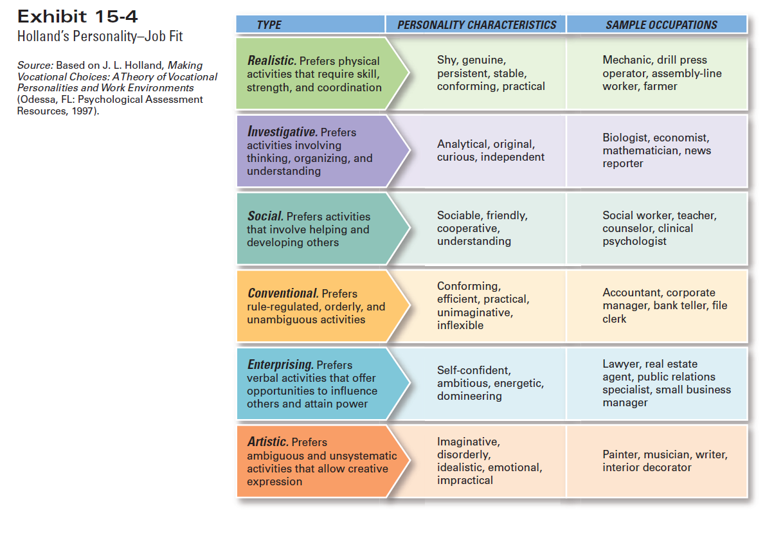
Exhibit 14.4 Holland’s Typology of Personality and Sample Occupations
Source: Based on J. L. Holland, Making Vocational Choices: A Theory of Vocational Personalities and Work Environments (Odessa, FL: Psychological Assessment Resources, 1997).
© 2007 Prentice Hall, Inc. All rights reserved.
14–<number>

Slide 58
Perception
Perception
  A process by which individuals give meaning (reality) to their environment by organizing and interpreting their sensory impressions.
  Perception is how people understand and make sense of the world around them using their senses.
Factors influencing perception:
  Your own interests, biases, and expectations shape how you see things. Example: If you like a coworker, you may notice their good work more.
  The target (what you’re observing): How different, noticeable, or similar something is affects perception. Example: A bright red car stands out more than a gray car.
  The situation (context) factors—place, time, location—draw attention or distract from the target.
© 2007 Prentice Hall, Inc. All rights reserved.
14–<number>

Slide 59
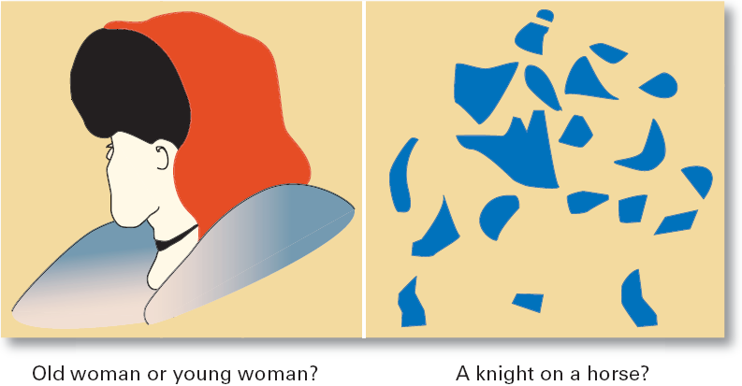
Exhibit 14.5 Perception Challenges: What Do You See?
© 2007 Prentice Hall, Inc. All rights reserved.
14–<number>

Slide 60
How We Perceive People
Attribution Theory
  How the actions of individuals are perceived by others depends on what meaning (causation) we attribute to a given behavior.
    Attribution Theory explains whether we think a person’s actions are caused by themselves or by the situation
    Internally caused behavior: under the individual’s control
    Externally caused behavior: due to outside factors
  Determining the source of behaviors:
    Distinctiveness: different behaviors in different situations
    Consensus: behaviors similar to others in same situation
    Consistency: regularity of the same behavior over time
© 2007 Prentice Hall, Inc. All rights reserved.
14–<number>

Slide 61
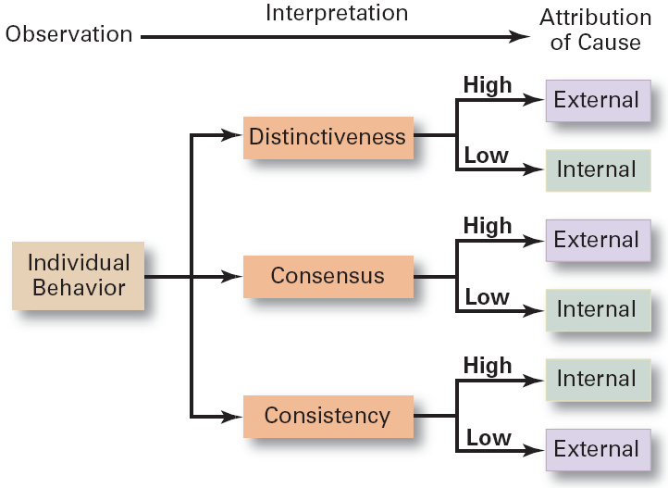
Exhibit 14.6 Attribution Theory
© 2007 Prentice Hall, Inc. All rights reserved.
14–<number>

Slide 62
How We Perceive People (cont’d)
Attribution Theory – errors and biases (cont’d)
  Fundamental attribution error
    The tendency to underestimate the influence of external factors and to overestimate the influence of internal or personal factors.
  Self-serving bias
    The tendency of individuals to attribute their successes to internal factors while blaming personal failures on external factors.
© 2007 Prentice Hall, Inc. All rights reserved.
14–<number>

Slide 63
Shortcuts Used in Judging Others
Assumed Similarity
  Assuming that others are more like us than they actually are.
Stereotyping
  Judging someone on the basis of our perception of a group he or she is a part of.
Halo Effect
  Forming a general impression of a person on the basis of a single characteristic of that person
© 2007 Prentice Hall, Inc. All rights reserved.
14–<number>

Slide 64
Implications for Managers
Employees react to perceptions
Pay close attention to how employees perceive their jobs and management actions
© 2007 Prentice Hall, Inc. All rights reserved.
14–<number>

Slide 65
Learning
Learning
  Learning is a lasting change in behavior that happens because of experience.
    Almost all complex behavior is learned.
    Learning is a continuous, life-long process.
    The principles of learning can be used to shape behavior
Theories of learning:
  Operant conditioning
  Social learning
© 2007 Prentice Hall, Inc. All rights reserved.
14–<number>

Slide 66
Learning (cont’d)
Operant Conditioning (B.F. Skinner)
  The theory that behavior is a function of its consequences and is learned through experience.
  People learn from the consequences of their actions.
  Operant behavior: voluntary or learned behaviors
  Voluntary behaviors are strengthened if rewarded and weakened if punished or ignored.
    Behaviors are learned by making rewards contingent to behaviors.
    Behavior that is rewarded (positively reinforced) is likely to be repeated. Reward: Giving a child a star for finishing homework → child does it again.
    Behavior that is punished or ignored is less likely to be repeated Punishment: Scolding a child for bad behavior → less likely to repeat it.
© 2007 Prentice Hall, Inc. All rights reserved.
14–<number>

Slide 67
Social Learning
  The theory that individuals learn through their observations of others and through their direct experiences.
  People learn by observing others and from their own experiences. A new employee learns proper customer service by watching a skilled coworker and seeing that polite behavior is praised.
  Attributes of models that influence learning:
    Attentional: the attractiveness or similarity of the model
    Retention: how well the model can be recalled
    Motor reproduction: the reproducibility of the model’s actions
    Reinforcement: the rewards associated with learning the model behavior
© 2007 Prentice Hall, Inc. All rights reserved.
14–<number>

Slide 68
Shaping: A Managerial Tool
Shaping Behavior
  Attempting to “mold” individuals by guiding their learning in graduated steps such that they learn to behave in ways that most benefit the organization.
  Shaping methods:
    Positive reinforcement: rewarding desired behaviors.
    Negative reinforcement: removing an unpleasant consequence once the desired behavior is exhibited.
    Punishment: penalizing an undesired behavior.
    Extinction: eliminating a reinforcement for an undesired behavior.
© 2007 Prentice Hall, Inc. All rights reserved.
14–<number>

Slide 69

Contemporary Issues in OB
Managing Generational Differences in the Workplace
  Gen Y: individuals born after 1978
    Bring new attitudes to the workplace that reflect wide arrays of experiences and opportunities
    Want to work, but don’t want work to be their life
    Challenge the status quo
    Have grown up with technology
© 2007 Prentice Hall, Inc. All rights reserved.
14–<number>

Slide 70
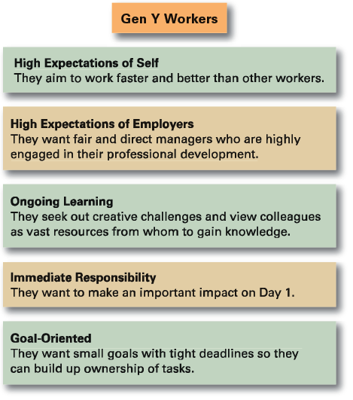
Exhibit 14.7 Gen Y Workers
© 2007 Prentice Hall, Inc. All rights reserved.
14–<number>
Source: Bruce Tulgan of Rainmaker Thinking. Used with permission.

Slide 71
Contemporary Issues in OB
Managing Negative Behavior in the Workplace
  Tolerating negative behavior sends the wrong message to other employees
  Both preventive and responsive actions to negative behaviors are needed:
    Screening potential employees
    Responding immediately and decisively to unacceptable behavior
    Paying attention to employee attitudes
© 2007 Prentice Hall, Inc. All rights reserved.
14–<number>

Slide 72
Terms to Know
behavior
organizational behavior
employee productivity
absenteeism
turnover
organizational citizenship behavior
job satisfaction
workplace misbehavior
attitudes
cognitive component
affective component
behavioral component
job involvement
organizational commitment
perceived organizational support
cognitive dissonance
attitude surveys
personality
big-five model
locus of control
Machiavellianism
© 2007 Prentice Hall, Inc. All rights reserved.
14–<number>

Slide 73
Terms to Know (cont’d)
self-esteem
self-monitoring
impression management
emotions
emotional intelligence (EI)
perception
attribution theory
fundamental attribution error
self-serving bias
assumed similarity
stereotyping
halo effect
learning
operant conditioning
social learning theory
shaping behavior
© 2007 Prentice Hall, Inc. All rights reserved.
14–<number>

